Slide 1
Challenges / Solutions: Fabrication

Slide 2
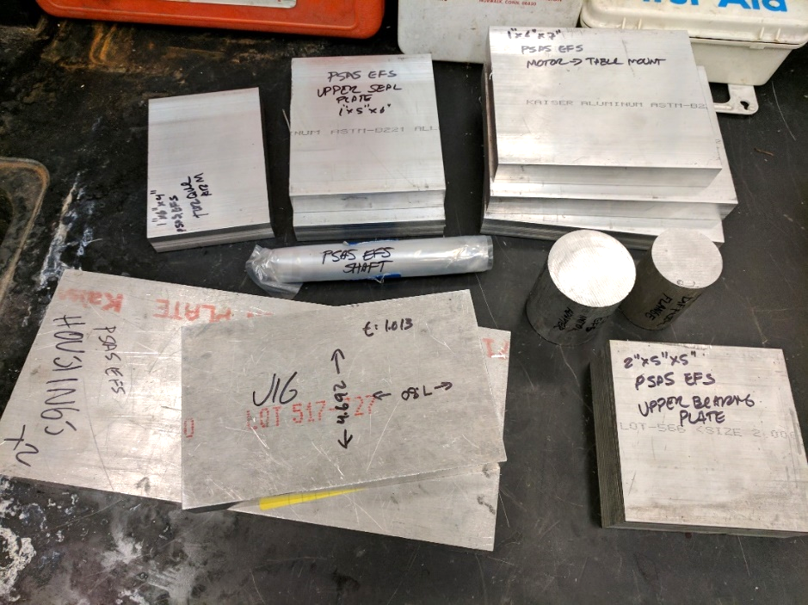
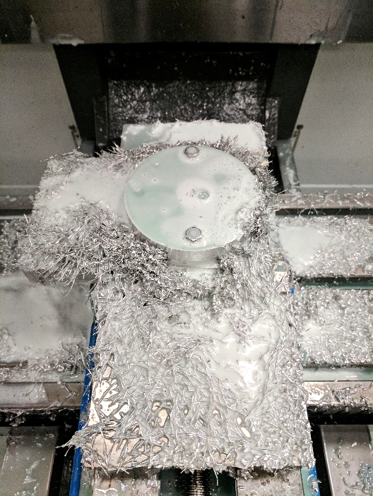
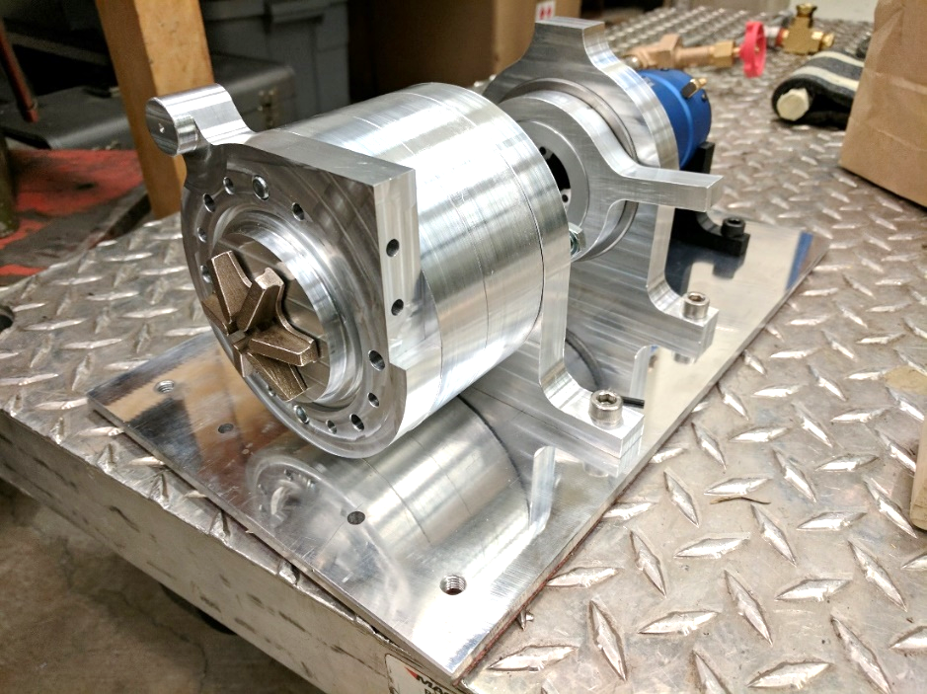
Challenges & Solutions: Fabrication
Head v. flow requirements meant commercially available pumps wouldn’t work.
Outsourcing fabrication would be cost prohibitive.

Slide 3
Challenges & Solutions: Fabrication Precision
High speeds and loads with low clearances meant fabrication had to be precise.
Insert series of images from Talik (impeller, impeller in housing, then add shaft and rest of stuff)

Slide 4
Challenges
To insert:
Quarter section – Cad Model
Bearing Schematic ? – Diagram
CNC operation – High res of john/james/kris
Hours in machine shop - Figure
Notes:
Casing Design and Manufacturing
Problems:
High RPMs / High Pressure
Alignment / Clearances / Fits
Ensuring Safe operation and preventing leakage
Solutions:
Bearing arrangement and selection
Seal / bushing
Precision execution with 3 axis CNC
Portland State Aerospace Society | Electric Propellant Feed System

Slide 5
Challenges
To insert:
Photo, highlight sensors
Photo, DAQ
Photo, Motor control
Notes:
2. Controls / Measurement
Problems:
Motor control
Sensing and measurement for performance curves
Solutions:
Quad Copter rigging / controller potentiometer tricking
Sensors
Arduino DAQ
Portland State Aerospace Society | Electric Propellant Feed System

